Slide 1
Class 2
Adjacency matrix
Eulerian circuit/trail
Pathlengths

Slide 2

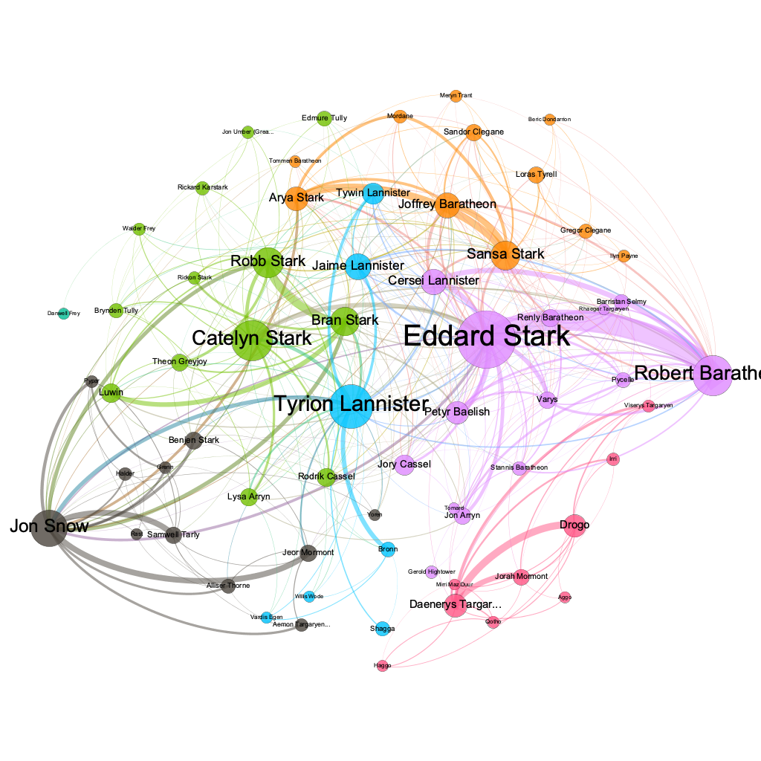
Text analysis
A Song of Ice and Fire by George R.R. Martin.
This is an interaction network and were created by connecting two characters whenever their names (or nicknames) appeared within 15 words of one another in one of the books. The edge weight corresponds to the number of interactions.
https://ericmjl.github.io/Network-Analysis-Made-Simple/05-casestudies/01-gameofthrones/

Slide 3
Network :structural chracteristics
Clustering Coefficients
Closeness Centrality
Betweenness Centrality
Eigenvector Centrality
Gephi
Notes:
The Human Disease Network, whose nodes are diseases connected if they have common genetic origin.
K.-I. Goh, M. E. Cusick, D. Valle, B. Childs, M. Vidal, and A.-L. Barabasi.
The human disease network. PNAS, 104:8685–8690, 2007.

Slide 4
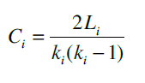
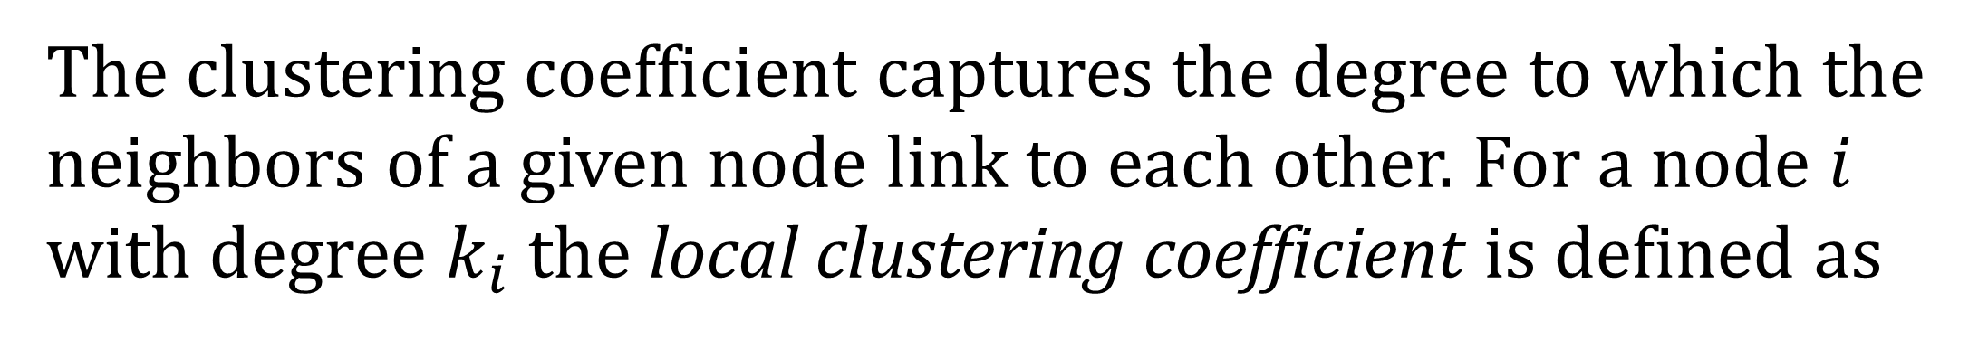
Clustering Coefficients
The clustering coefficient captures the degree to which the neighbors of a given node link to each other. For a node $i$ with degree $k_{i}$ the local clustering coefficient is defined as
Notes:
The Human Disease Network, whose nodes are diseases connected if they have common genetic origin.
K.-I. Goh, M. E. Cusick, D. Valle, B. Childs, M. Vidal, and A.-L. Barabasi.
The human disease network. PNAS, 104:8685–8690, 2007.

Slide 5
Clustering Coefficients
The clustering coefficient captures the degree to which the neighbors of a given node link to each other. For a node $i$ with degree $k_{i}$ the local clustering coefficient is defined as
CC of the center node (purple)
Notes:
The Human Disease Network, whose nodes are diseases connected if they have common genetic origin.
K.-I. Goh, M. E. Cusick, D. Valle, B. Childs, M. Vidal, and A.-L. Barabasi.
The human disease network. PNAS, 104:8685–8690, 2007.

Slide 6
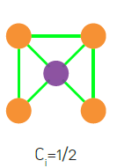
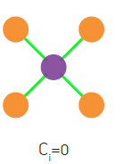
Clustering Coefficients
The clustering coefficient captures the degree to which the neighbors of a given node link to each other. For a node $i$ with degree $k_{i}$ the local clustering coefficient is defined as
CC of the center node (purple)
Notes:
The Human Disease Network, whose nodes are diseases connected if they have common genetic origin.
K.-I. Goh, M. E. Cusick, D. Valle, B. Childs, M. Vidal, and A.-L. Barabasi.
The human disease network. PNAS, 104:8685–8690, 2007.

Slide 7
Clustering Coefficients
Notes:
The Human Disease Network, whose nodes are diseases connected if they have common genetic origin.
K.-I. Goh, M. E. Cusick, D. Valle, B. Childs, M. Vidal, and A.-L. Barabasi.
The human disease network. PNAS, 104:8685–8690, 2007.

Slide 8
Clustering Coefficients
n=length(G);
C=zeros(n,1);
for u=1:n
V=find(G(u,:));
k=length(V);
if k>=2 %degree must be at least 2
S=G(V,V);
C(u)=sum(S(:))/(k^2-k);
end
end
https://github.com/mdhumphries/SmallWorldNess
Notes:
The Human Disease Network, whose nodes are diseases connected if they have common genetic origin.
K.-I. Goh, M. E. Cusick, D. Valle, B. Childs, M. Vidal, and A.-L. Barabasi.
The human disease network. PNAS, 104:8685–8690, 2007.

Slide 9
Clustering Coefficients
Notes:
The Human Disease Network, whose nodes are diseases connected if they have common genetic origin.
K.-I. Goh, M. E. Cusick, D. Valle, B. Childs, M. Vidal, and A.-L. Barabasi.
The human disease network. PNAS, 104:8685–8690, 2007.

Slide 10
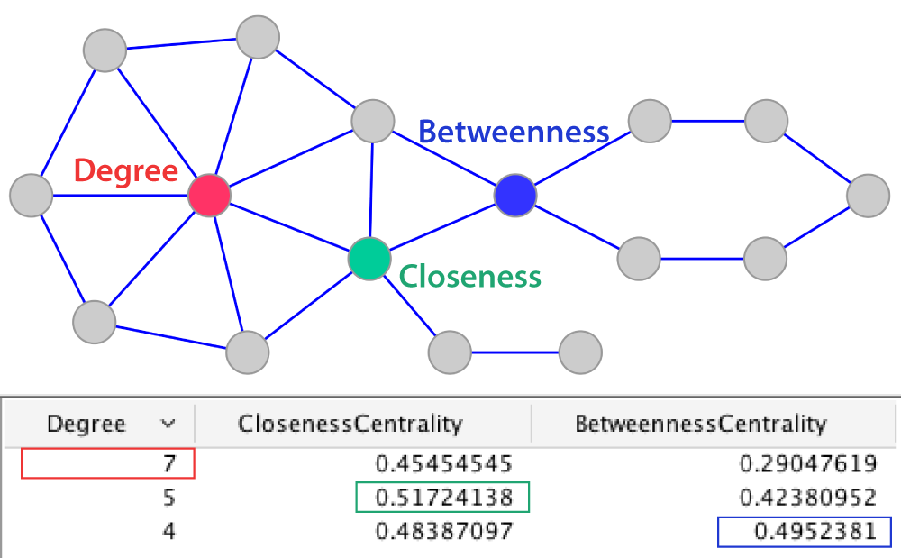
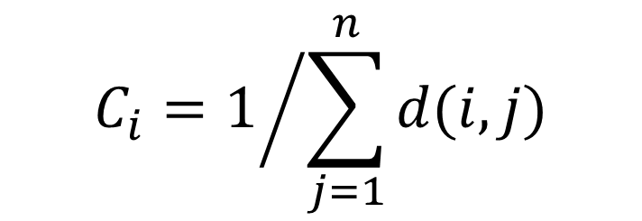
Centralities
$$C_{i}=1/{\sum_{j=1}^{n}{d(i,j)}}$$
Ralucca Gera, NPS

Slide 11
Centralities
$$C_{i}=1/{\sum_{j=1}^{n}{d(i,j)}}$$
Ralucca Gera, NPS

Slide 12
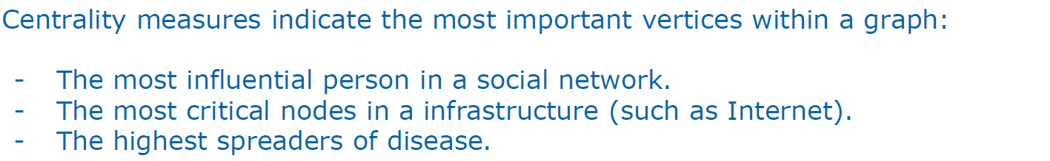
Network Analysis: Centrality measures

Slide 13
Network Analysis: Centrality measures

Slide 14
Different types of centralities
What makes a vertex central in a network? (one or more ideas) | How do you describe it mathematically? | When is it appropriate to use it? | How can we capture it?

Slide 15
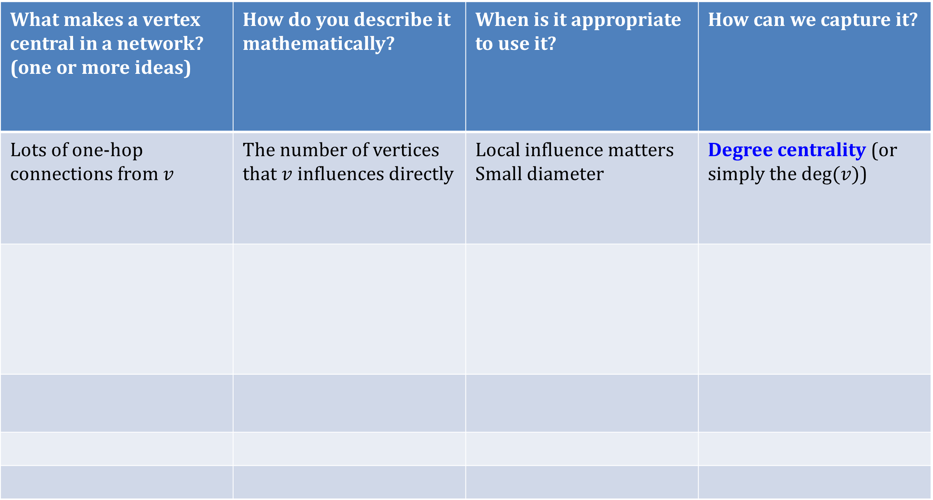
Different types of centralities
What makes a vertex central in a network? (one or more ideas) | How do you describe it mathematically? | When is it appropriate to use it? | How can we capture it?
Lots of one-hop connections from $v$ | The number of vertices that $v$ influences directly | Local influence matters Small diameter | Degree centrality (or simply the $deg⁡(v)$)

Slide 16
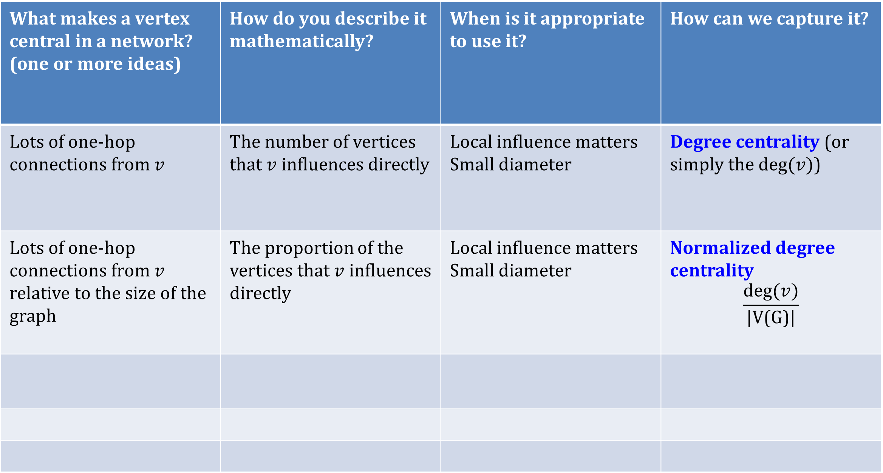
Different types of centralities
What makes a vertex central in a network? (one or more ideas) | How do you describe it mathematically? | When is it appropriate to use it? | How can we capture it?
Lots of one-hop connections from $v$ | The number of vertices that $v$ influences directly | Local influence matters Small diameter | Degree centrality (or simply the $deg⁡(v)$)
Lots of one-hop connections from $v$ relative to the size of the graph | The proportion of the vertices that $v$ influences directly | Local influence matters Small diameter | Normalized degree centrality $$\frac{deg⁡(v)}{\text{|}\text{V}\text{(}\text{G}\text{)|}}$$

Slide 17
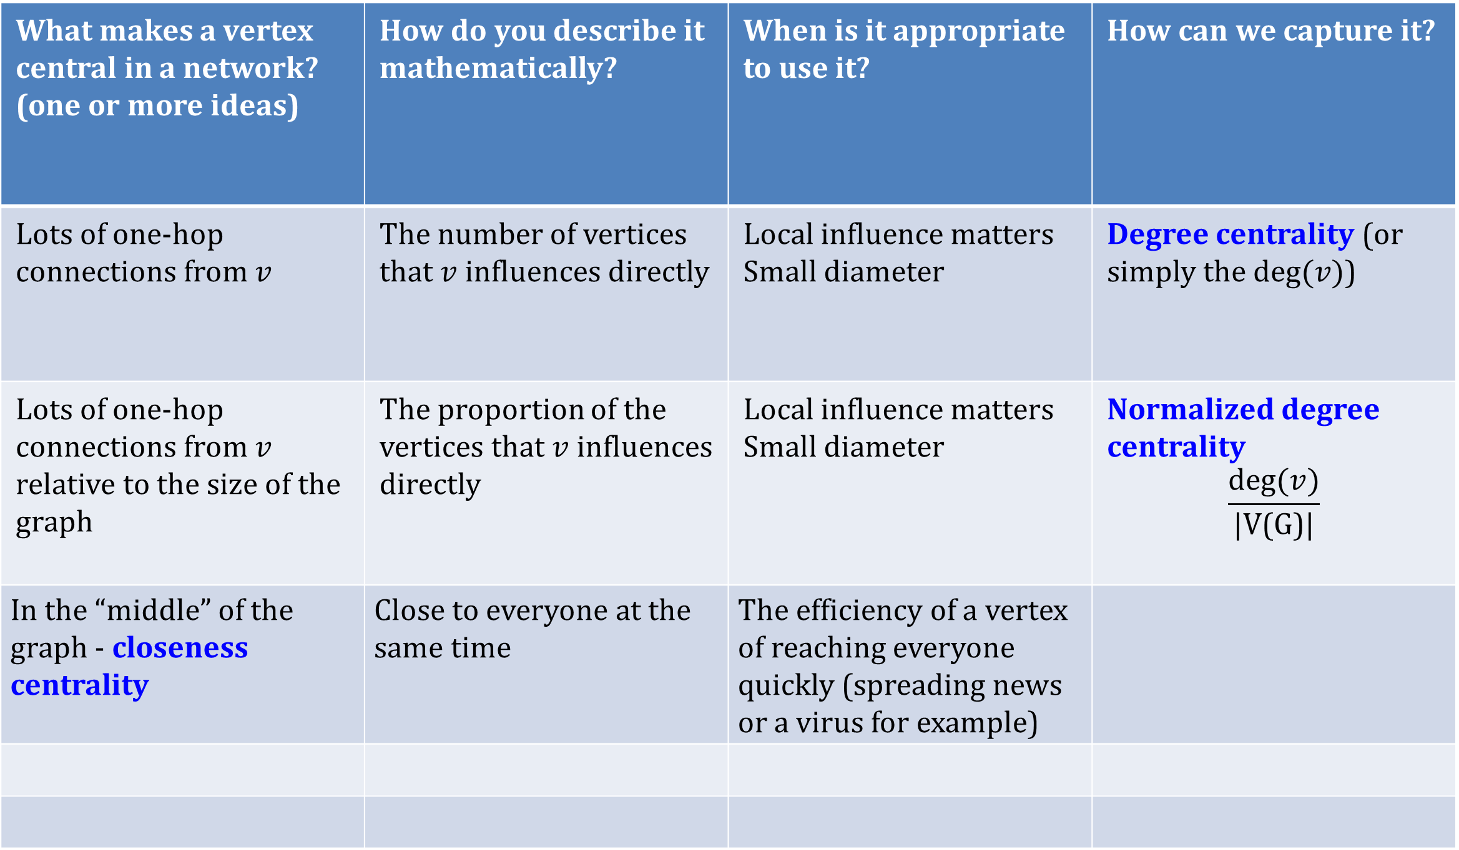
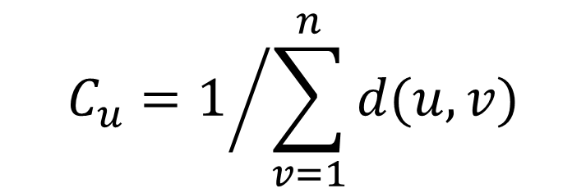
Different types of centralities
What makes a vertex central in a network? (one or more ideas) | How do you describe it mathematically? | When is it appropriate to use it? | How can we capture it?
Lots of one-hop connections from $v$ | The number of vertices that $v$ influences directly | Local influence matters Small diameter | Degree centrality (or simply the $deg⁡(v)$)
Lots of one-hop connections from $v$ relative to the size of the graph | The proportion of the vertices that $v$ influences directly | Local influence matters Small diameter | Normalized degree centrality $$\frac{deg⁡(v)}{\text{|}\text{V}\text{(}\text{G}\text{)|}}$$
In the “middle” of the graph - closeness centrality | Close to everyone at the same time | The efficiency of a vertex of reaching everyone quickly (spreading news or a virus for example)
$$C_{u}=1/{\sum_{v=1}^{n}{d(u,v)}}$$

Slide 19
Event synchronization
#pk, Saral APP

Slide 23
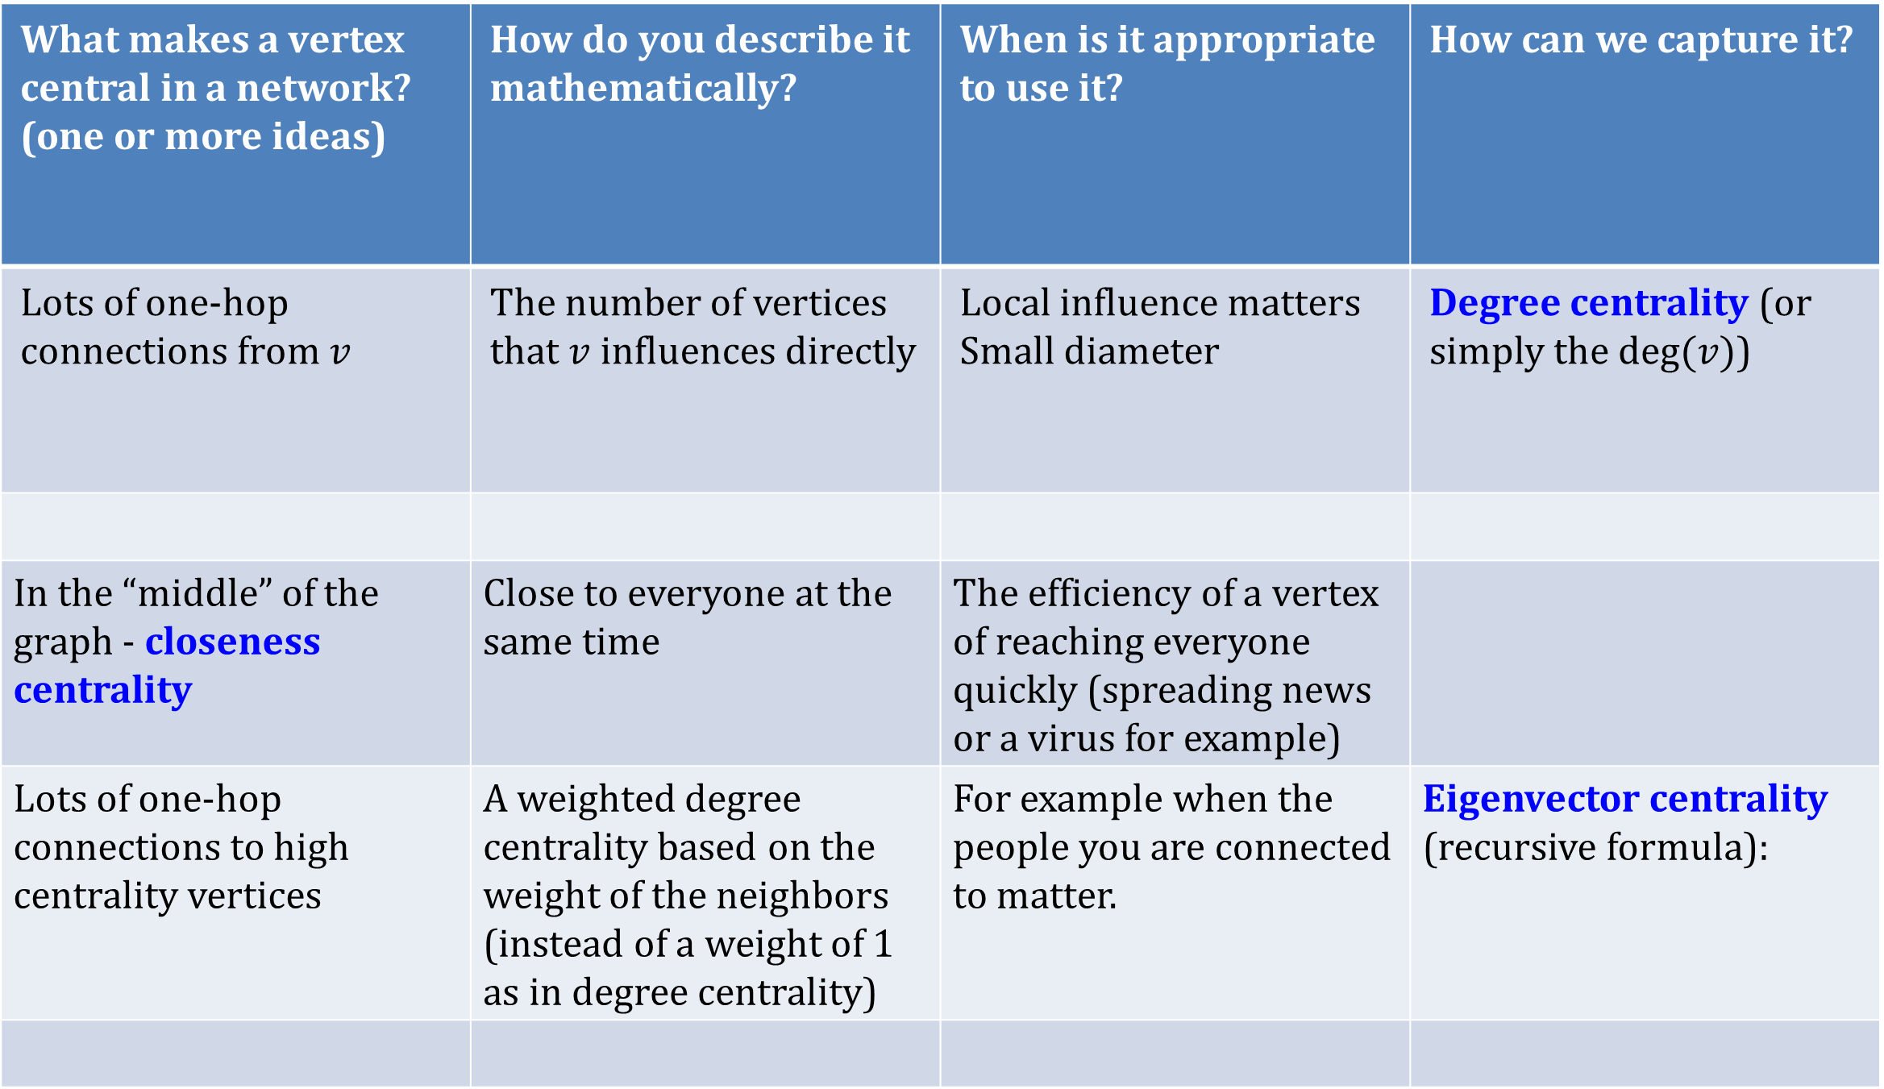
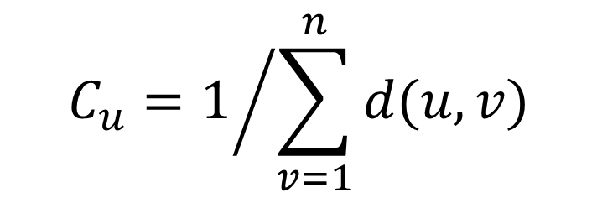
Different types of centralities
What makes a vertex central in a network? (one or more ideas) | How do you describe it mathematically? | When is it appropriate to use it? | How can we capture it?
Lots of one-hop connections from $v$ | The number of vertices that $v$ influences directly | Local influence matters Small diameter | Degree centrality (or simply the $deg⁡(v)$)
In the “middle” of the graph - closeness centrality | Close to everyone at the same time | The efficiency of a vertex of reaching everyone quickly (spreading news or a virus for example)
Lots of one-hop connections to high centrality vertices | A weighted degree centrality based on the weight of the neighbors (instead of a weight of 1 as in degree centrality) | For example when the people you are connected to matter. | Eigenvector centrality (recursive formula):
$$C_{u}=1/{\sum_{v=1}^{n}{d(u,v)}}$$
Ralucca Gera, NPS

Slide 24
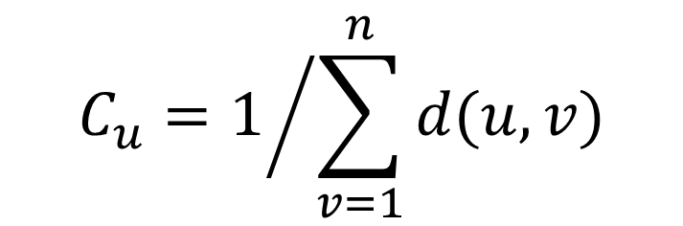
Closeness Centrality
Reciprocal of the total distance from a node v to all the other nodes in a network
d(u,v) is the distance between node u and v.
$$C_{u}=1/{\sum_{v=1}^{n}{d(u,v)}}$$
$$C_{i}=1/{\sum_{j=1}^{n}{d(i,j)}}$$
Closeness centrality can be viewed as the efficiency of a vertex in spreading information to all other vertices.
Ralucca Gera, NPS

Slide 25
Eigenvector Centrality
A natural extension of degree centrality is eigenvector centrality.
$$C_{i}=1/{\sum_{j=1}^{n}{d(i,j)}}$$
Ralucca Gera, NPS

Slide 26
Eigenvector Centrality
A natural extension of degree centrality is eigenvector centrality.
In-degree centrality awards one centrality point for every link a node receives. But not all vertices are equivalent: some are more relevant than others, and, reasonably, endorsements from important nodes count more.
$$C_{i}=1/{\sum_{j=1}^{n}{d(i,j)}}$$
Ralucca Gera, NPS

Slide 27
Eigenvector Centrality
A natural extension of degree centrality is eigenvector centrality.
In-degree centrality awards one centrality point for every link a node receives. But not all vertices are equivalent: some are more relevant than others, and, reasonably, endorsements from important nodes count more.
EVC : A node is important if it is linked to by other important nodes.
$$C_{i}=1/{\sum_{j=1}^{n}{d(i,j)}}$$
Ralucca Gera, NPS

Slide 28
Eigenvector Centrality
$$C_{i}=1/{\sum_{j=1}^{n}{d(i,j)}}$$
Ralucca Gera, NPS

Slide 29
Eigenvector Centrality
$$C_{i}=1/{\sum_{j=1}^{n}{d(i,j)}}$$
Ralucca Gera, NPS

Slide 30
Eigenvector Centrality
$$C_{i}=1/{\sum_{j=1}^{n}{d(i,j)}}$$
Ralucca Gera, NPS

Slide 31
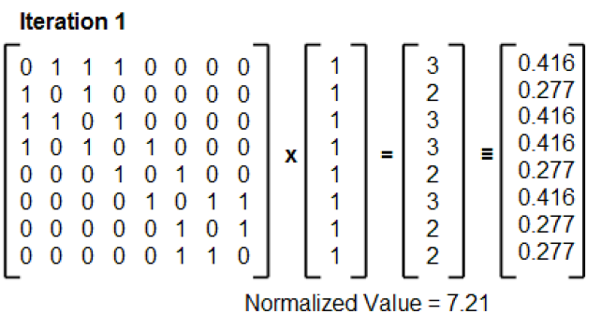
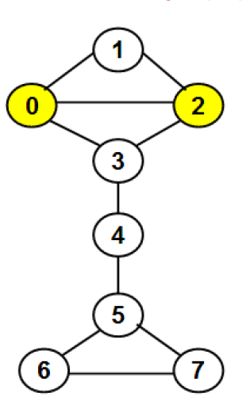
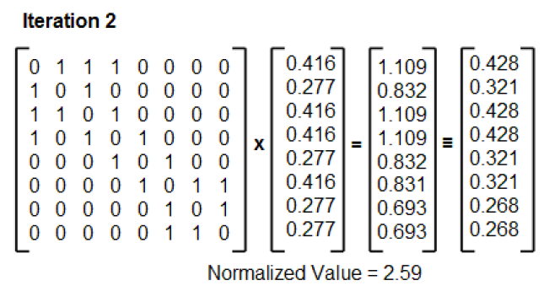
Eigenvector Centrality
$$C_{i}=1/{\sum_{j=1}^{n}{d(i,j)}}$$
Dr. Natarajan Meghanathan
Ralucca Gera, NPS

Slide 32
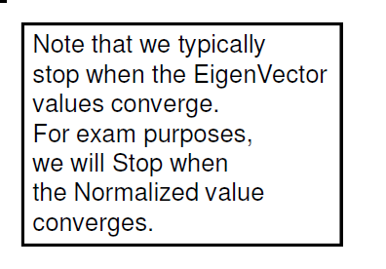
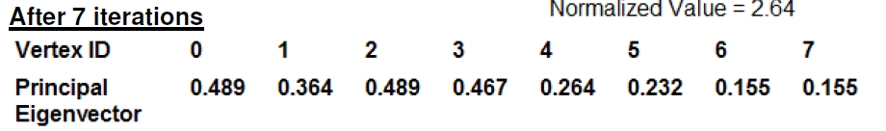
Eigenvector Centrality
$$C_{i}=1/{\sum_{j=1}^{n}{d(i,j)}}$$
Ralucca Gera, NPS

Slide 33
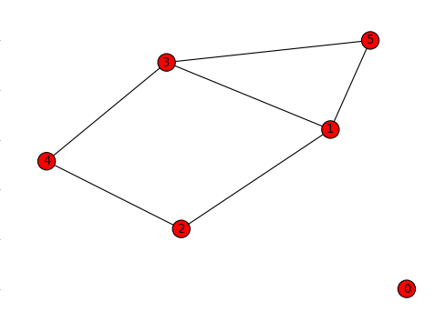
Eigenvector Centrality
clear all
A=zeros(6,6);
A(5,[1 3])=1;
A(2,[1 4])=1;
A([1 4],3)=1;
A=A+A';
[u lam]=eig(A);
evc_large=u(:,6);
$$C_{i}=1/{\sum_{j=1}^{n}{d(i,j)}}$$
Ralucca Gera, NPS

Slide 34
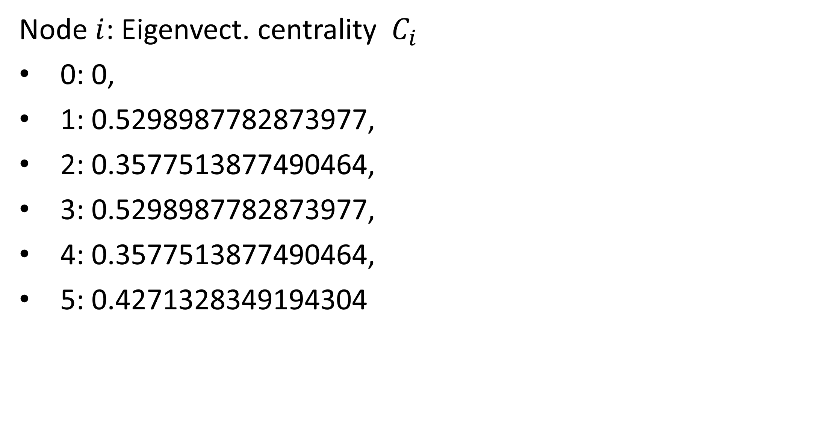
Eigenvector Centrality
Example 1 (Eigenvector centrality)
Node $i$: Eigenvect. centrality $C_{i}$
0: 0,
1: 0.5298987782873977,
2: 0.3577513877490464,
3: 0.5298987782873977,
4: 0.3577513877490464,
5: 0.4271328349194304

Slide 35
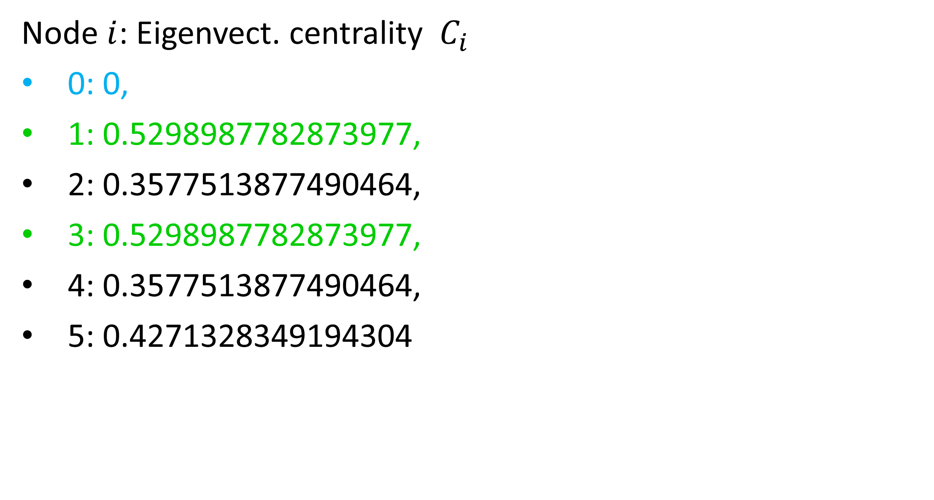
Eigenvector Centrality
Example 1 (Eigenvector centrality)
Node $i$: Eigenvect. centrality $C_{i}$
0: 0,
1: 0.5298987782873977,
2: 0.3577513877490464,
3: 0.5298987782873977,
4: 0.3577513877490464,
5: 0.4271328349194304

Slide 36
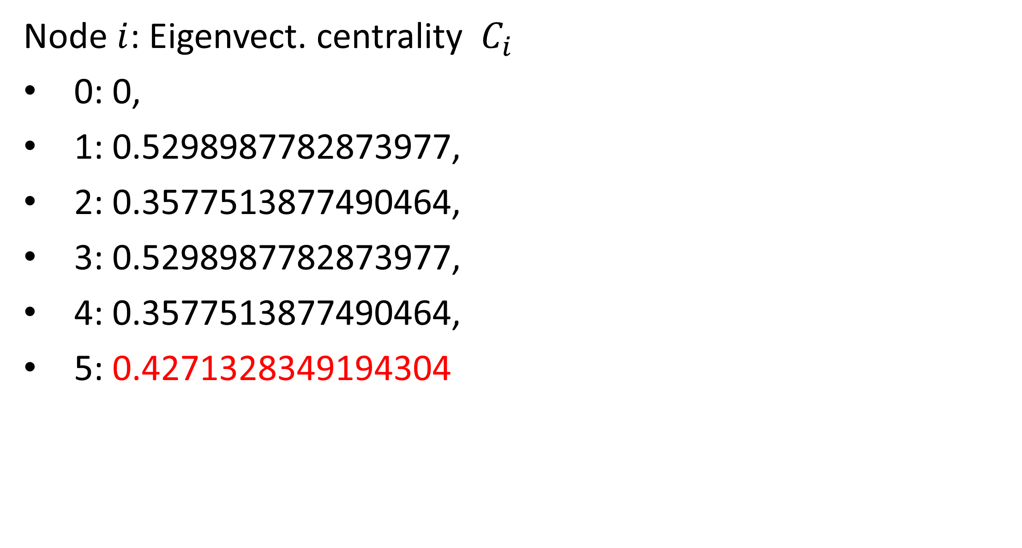
Eigenvector Centrality
Example 1 (Eigenvector centrality)
Node $i$: Eigenvect. centrality $C_{i}$
0: 0,
1: 0.5298987782873977,
2: 0.3577513877490464,
3: 0.5298987782873977,
4: 0.3577513877490464,
5: 0.4271328349194304
Notice that deg(5) = deg (4). Why $C_{5}>C_{4} ?$

Slide 37
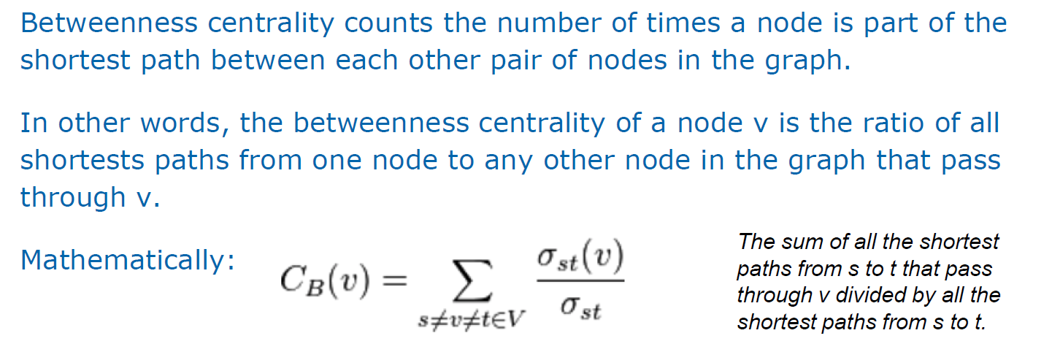
Node Betweenness
$$C_{i}=1/{\sum_{j=1}^{n}{d(i,j)}}$$
Shortest path based betweenness centrality
Ralucca Gera, NPS

Slide 38
Centralities
$$C_{i}=1/{\sum_{j=1}^{n}{d(i,j)}}$$
Ralucca Gera, NPS

Slide 39
Centralities
betweenness closeness
1 7 0.381944444444445 0.454545454545455
2 3 0 0.405405405405405
3 3 0 0.384615384615385
4 3 0 0.333333333333333
5 3 0 0.333333333333333
6 3 0 0.333333333333333
7 4 0.244444444444444 0.483870967741936
8 5 0.475000000000000 0.517241379310345
9 4 0.604166666666667 0.483870967741936
10 2 0.225000000000000 0.365853658536585
11 2 0.0930555555555556 0.294117647058824
12 2 0.0208333333333333 0.245901639344262
13 2 0.0166666666666667 0.294117647058824
14 2 0.148611111111111 0.365853658536585
15 2 0.208333333333333 0.365853658536585
16 1 0 0.272727272727273
$$C_{i}=1/{\sum_{j=1}^{n}{d(i,j)}}$$
Ralucca Gera, NPS

Slide 40
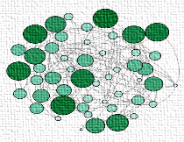
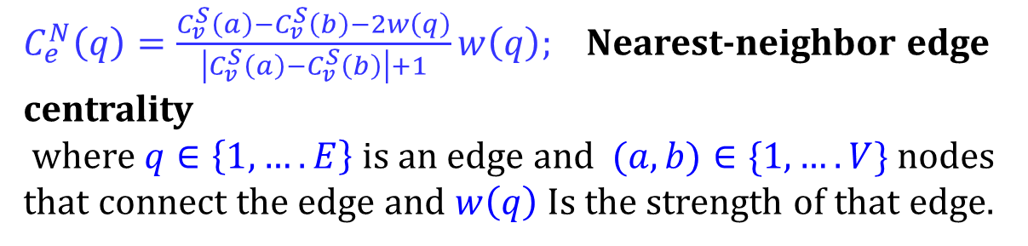
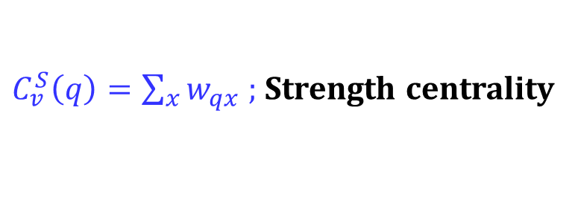

Node-based and edge-based centralites
$C_{v}^{S}\left(q\right)=\sum_{x}{w_{qx} }$; Strength centrality
$C_{e}^{N}\left(q\right)=\frac{C_{v}^{S}\left(a\right)−C_{v}^{S}\left(b\right)−2w\left(q\right)}{\left|C_{v}^{S}\left(a\right)−C_{v}^{S}\left(b\right)\right|+1}w\left(q\right)$; Nearest-neighbor edge centrality
where $q∈\left\{1,….E\right\}$ is an edge and $(a,b)∈\{1, ….V\}$ nodes that connect the edge and $w\left(q\right)$ Is the strength of that edge.
Centrality-based identification of important edges in complex networks T Bröhl, K Lehnertz, Chaos: An Interdisciplinary Journal of Nonlinear Science 29 (3)
A straightforward edge centrality concept derived from generalizing degree and strength, T Bröhl, K Lehnertz, Scientific Reports 12 (1), 4407

Slide 41
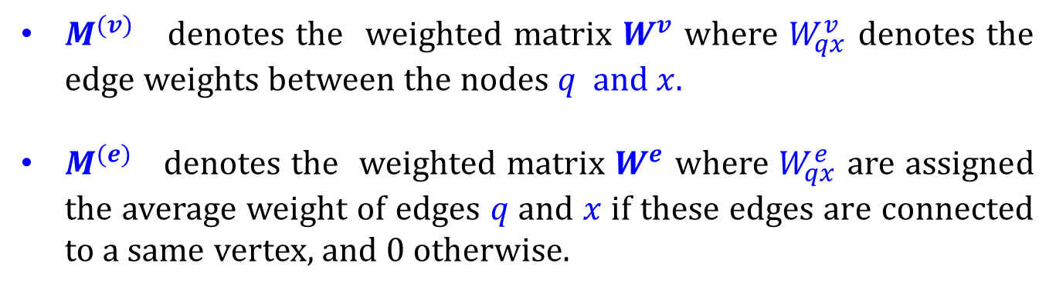
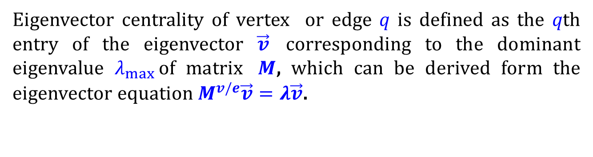
Node-based and edge-based centralites
$C_{v,e}^{E}\left(q\right)=\frac{1}{λ_{max}}\sum_{x}{M_{qx}^{v/e} C_{v,e}^{E}}\left(x\right)$ ; Eigenvector centrality
Eigenvector centrality of vertex or edge 𝑞 is defined as the 𝑞th entry of the eigenvector $\vec{v}$ corresponding to the dominant eigenvalue $λ_{max}⁡$of matrix $M$, which can be derived form the eigenvector equation $M^{v/e}\vec{v}=λ\vec{v}$.
$M^{(v)}$ denotes the weighted matrix $W^{v}$ where $W_{qx}^{v}$ denotes the edge weights between the nodes $q$ and $x.$
$M^{(e)}$ denotes the weighted matrix $W^{e}$ where $W_{qx}^{e}$ are assigned the average weight of edges 𝑞 and 𝑥 if these edges are connected to a same vertex, and 0 otherwise.

Slide 42
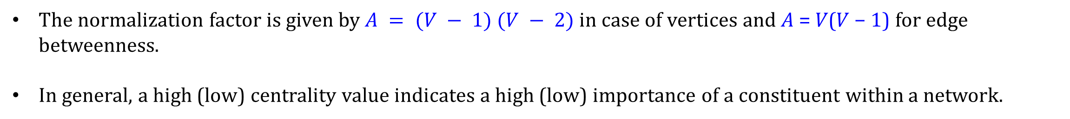
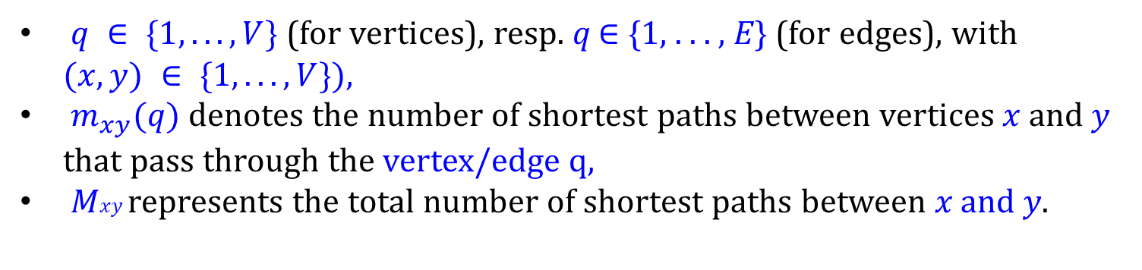
Node-based and edge-based centralites
$C_{v,e}^{B}(q)=\frac{2}{A}\sum_{x≠y}{\frac{m_{xy}(q)}{M_{xy}}\text{ ; }\text{B}\text{etweenness} \text{centrality}}$
$q ∈ \{1, . . . ,V\}$(for vertices), resp. 𝑞 ∈ {1, . . . , 𝐸} (for edges), with $(x, y) ∈ \{1, . . . ,V\}),$
$m_{xy}(q)$denotes the number of shortest paths between vertices 𝑥 and 𝑦 that pass through the vertex/edge q,
𝑀𝑥𝑦 represents the total number of shortest paths between 𝑥 and 𝑦.
The normalization factor is given by $A = (V − 1) (V − 2)$in case of vertices and 𝐴 = 𝑉(𝑉 − 1) for edge betweenness.
In general, a high (low) centrality value indicates a high (low) importance of a constituent within a network.

Slide 43
Node-based and edge-based centralites
$C_{v}^{C}(q)=\frac{V−1}{\sum_{x}{m_{qx}}}$; Vertex closeness centrality
$C_{e}^{C}(q)=\frac{E−1}{\sum_{x}{m_{xa}+m_{xb}}}$ ; Edge closeness centrality

Slide 44
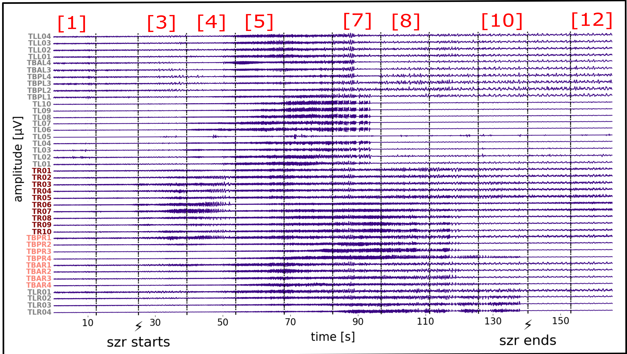

Slide 45
Complete and bipartite graph
The complete graph on n vertices is denoted K_{n}, and is the graph on n vertices where every pair of distinct vertices are adjacent.
A bipartite graph is one where the vertices are divided into two classes, R and B say, with the property that every edge has one end in R and the other end in B. Star and lattices.

Slide 46
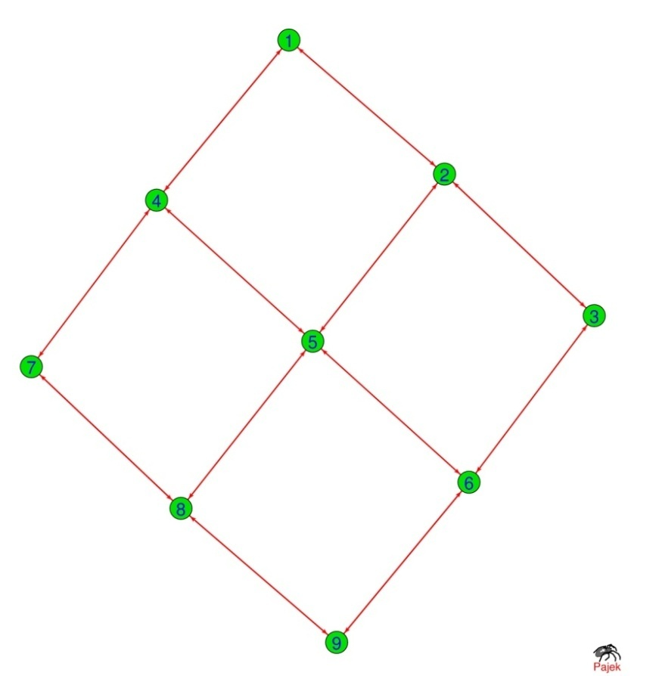
Bipartite graph
1
3
5
7
9
4
2
6
8

Slide 47
Bipartite Graphs: Subprojections
A bipartite graph (or bigraph) is a network whose nodes can be divided into two disjoint sets U and V such that each link connects a U-node to a V-node. In other words, if we color the U-nodes green and the V-nodes purple, then each link must connect nodes of different colors.
Notes:
The Human Disease Network, whose nodes are diseases connected if they have common genetic origin.
K.-I. Goh, M. E. Cusick, D. Valle, B. Childs, M. Vidal, and A.-L. Barabasi.
The human disease network. PNAS, 104:8685–8690, 2007.

Slide 48
Examples of complex networks: geometric, regular
Human Disease Network
Notes:
The Human Disease Network, whose nodes are diseases connected if they have common genetic origin.
K.-I. Goh, M. E. Cusick, D. Valle, B. Childs, M. Vidal, and A.-L. Barabasi.
The human disease network. PNAS, 104:8685–8690, 2007.

Slide 49
Examples of complex networks: geometric, regular
Human Disease Network: Two Projections
Notes:
The Human Disease Network, whose nodes are diseases connected if they have common genetic origin.
K.-I. Goh, M. E. Cusick, D. Valle, B. Childs, M. Vidal, and A.-L. Barabasi.
The human disease network. PNAS, 104:8685–8690, 2007.

Slide 50
Actor Networks
In network theory we encounter numerous bipartite networks. A well-known example is the Hollywood actor network, in which one set of nodes corresponds to movies (U), and the other to actors (V). A movie is connected to an actor if the actor plays in that movie
Notes:
The Human Disease Network, whose nodes are diseases connected if they have common genetic origin.
K.-I. Goh, M. E. Cusick, D. Valle, B. Childs, M. Vidal, and A.-L. Barabasi.
The human disease network. PNAS, 104:8685–8690, 2007.

Slide 51
Flavor Networks
Notes:
The Human Disease Network, whose nodes are diseases connected if they have common genetic origin.
K.-I. Goh, M. E. Cusick, D. Valle, B. Childs, M. Vidal, and A.-L. Barabasi.
The human disease network. PNAS, 104:8685–8690, 2007.

Slide 52
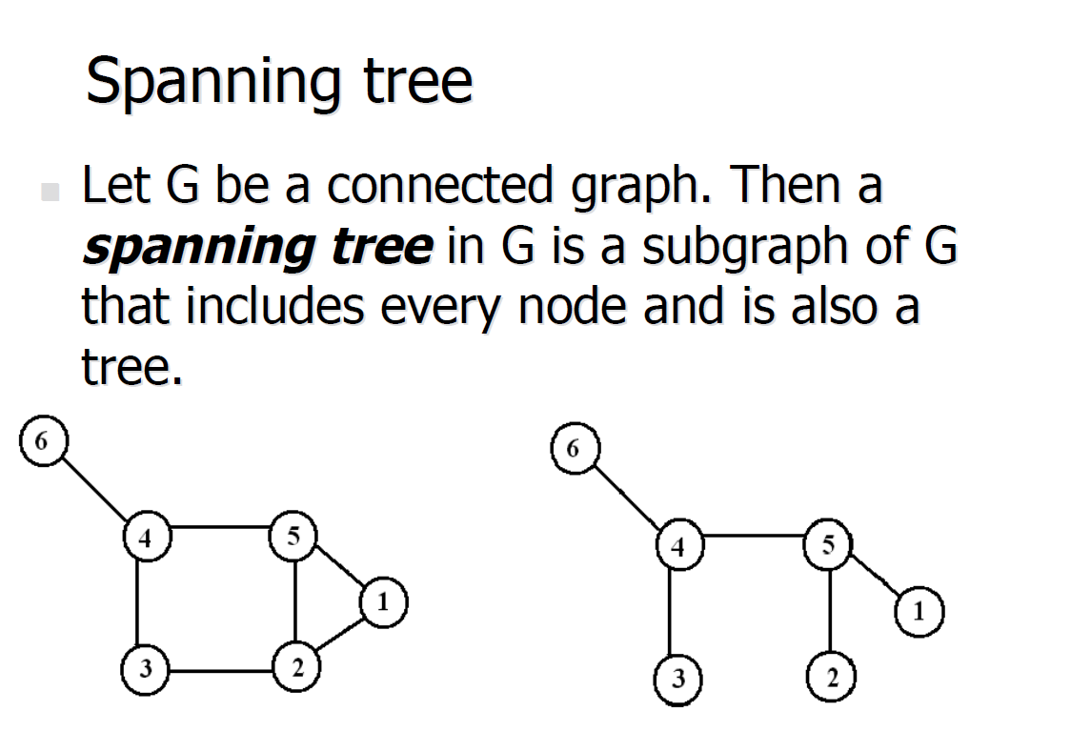
Spanning Tree
Notes:
The Human Disease Network, whose nodes are diseases connected if they have common genetic origin.
K.-I. Goh, M. E. Cusick, D. Valle, B. Childs, M. Vidal, and A.-L. Barabasi.
The human disease network. PNAS, 104:8685–8690, 2007.

